Slide 1
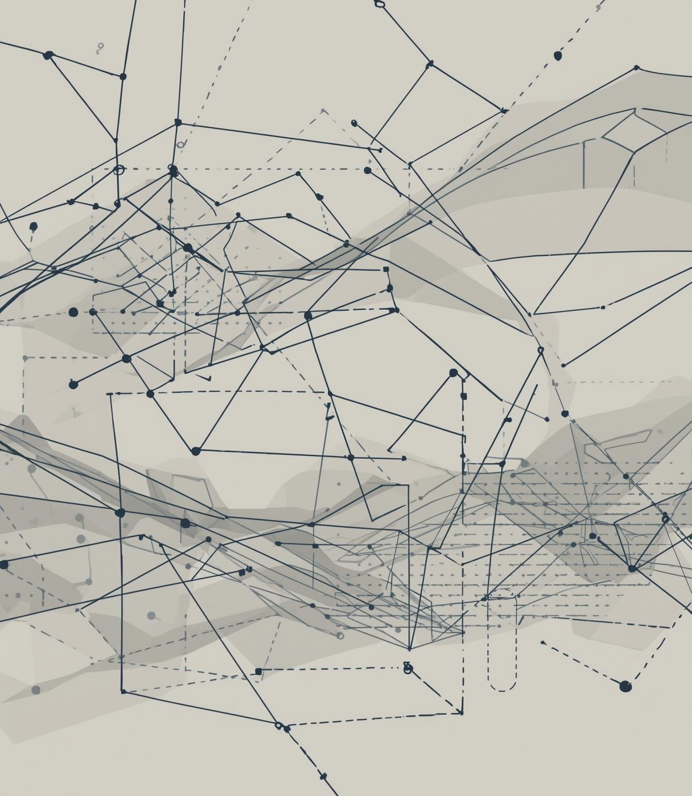

SWELL
Synthetic Data
PRESENTED BY
TELUGU THARUN KUMAR

Slide 2
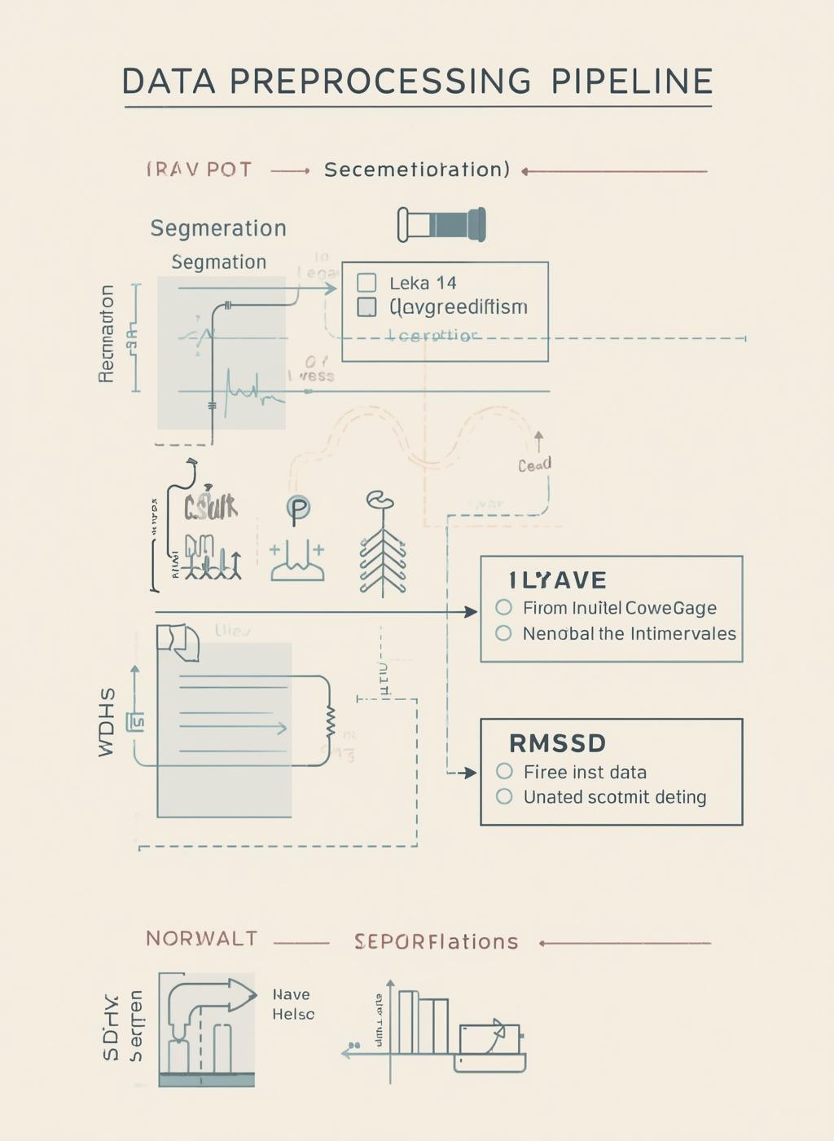
SWELL Dataset Overview
The SWELL HRV dataset, sourced from Kaggle, segments 10-minute windows of heart rate variability, encompassing critical metrics for stress analysis and subsequent modeling processes.

Slide 3
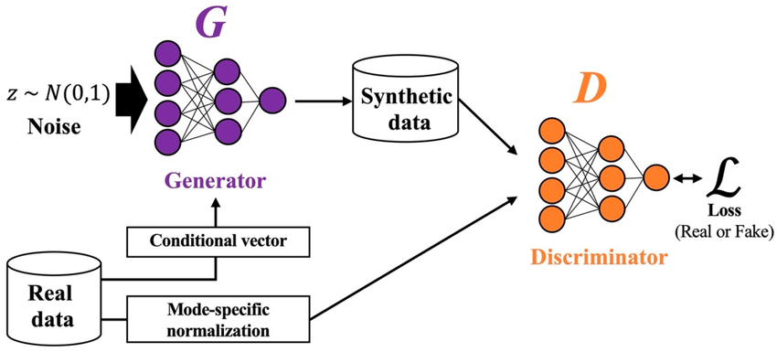
Justifying CTGAN
CTGAN is essential for synthetic HRV signal generation, effectively handling mixed-type data and imbalances while preserving the critical stress-related patterns inherent in HRV metrics.

Slide 4
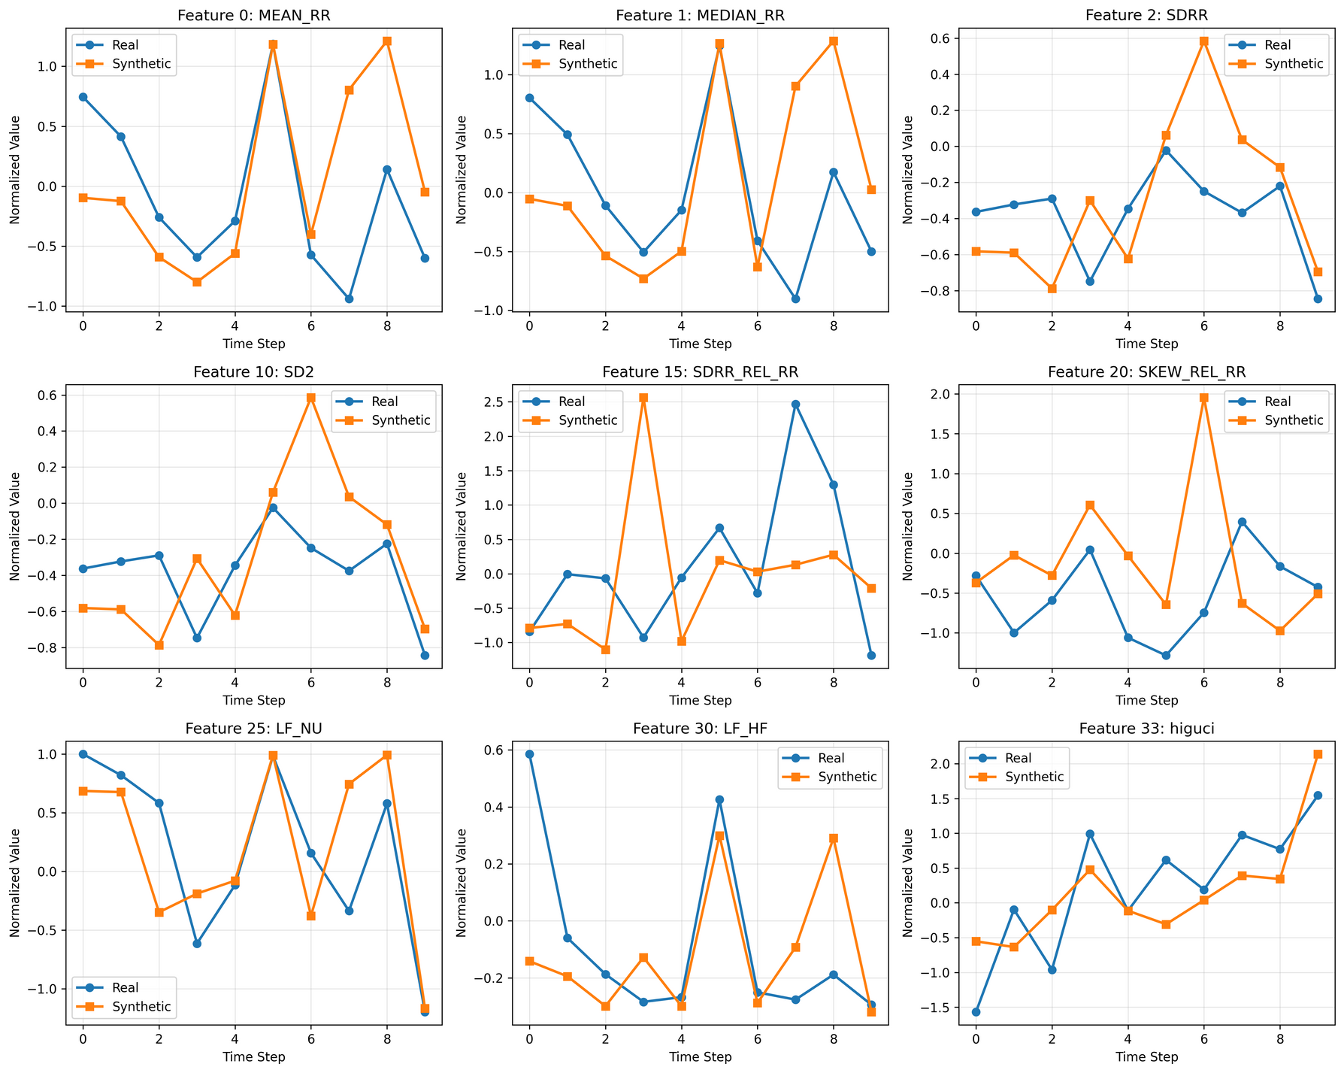
Synthetic vs Real Comparison
This section highlights the similarities between synthetic and real HRV data, demonstrating that our CTGAN-generated sequences effectively replicate the characteristics of genuine human heart rate variability.

Slide 5
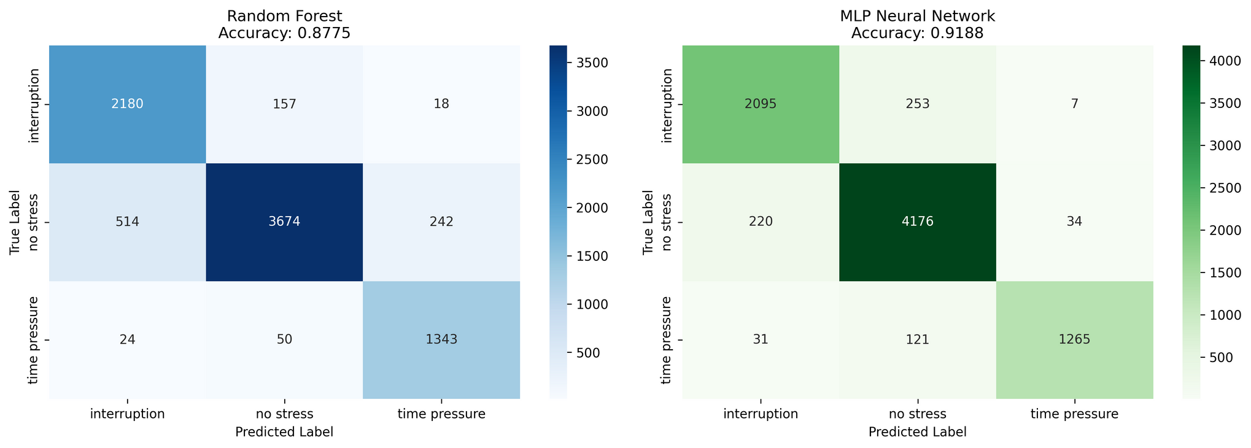
Evaluation Metrics
RANDOM FOREST ACCURACY
0.8775
MLP ACCURACY
0.9188
F1 SCORE
≈ 0.90

Slide 6
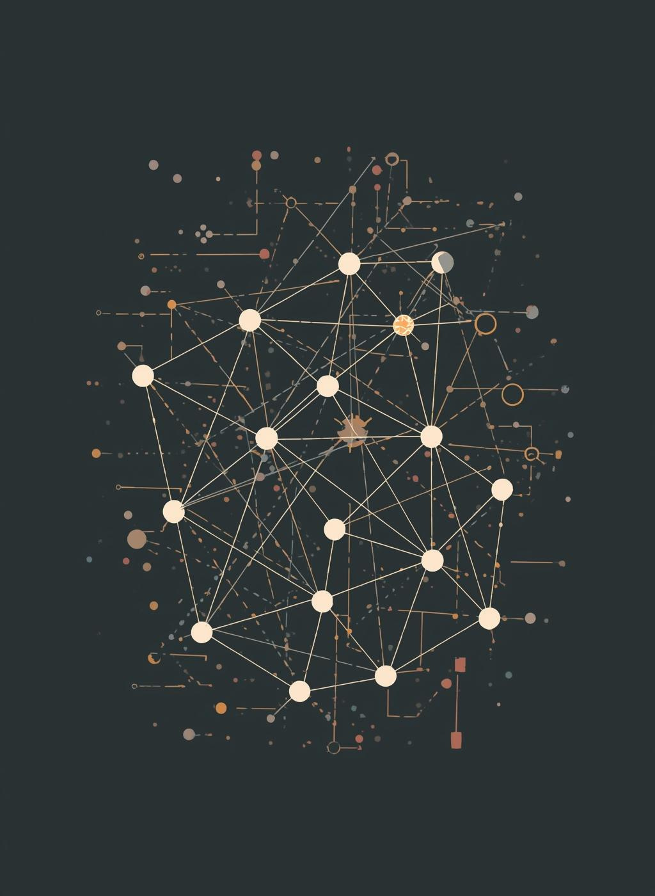
Conclusions & Insights
The CTGAN approach effectively preserved HRV stress patterns, validating the high-quality synthetic data generated, which enables privacy-preserving modeling and scalable augmentation for future research.

